Slide 1

TEAM 15
Price Purvis, Drew Buley, Jaiden Beck, Wil Davis, Chad Stark

Slide 2

ECE 4950 Project Overview
Summary
Pool Shark is an autonomous mini‑pool system where the user selects a ball and pocket via GUI. The robot calculates the optimal shot path and uses a modified cue to strike the cue ball, potting the chosen ball. The system must deliver quiet, efficient, safe, and user‑friendly gameplay with smooth closed‑loop motion control.
Customer Requirements
Quiet, efficient, fast, and safe operation
User‑friendly GUI for ball & pocket selection
Accurate potting of chosen ball into selected pocket
Cue ball may be potted, 8‑ball forbidden
Smooth, reliable gameplay experience
Engineering Requirements
Closed‑loop motion control for precise cue positioning
Smooth motion for all moving components (except cue strike)
Optimal shot path calculation based on ball & pocket input
GUI integration with control logic
Modified cue mechanism for consistent striking
Stable system mount along table width
Clemson University | Electrical & Computer Engineering

Slide 3
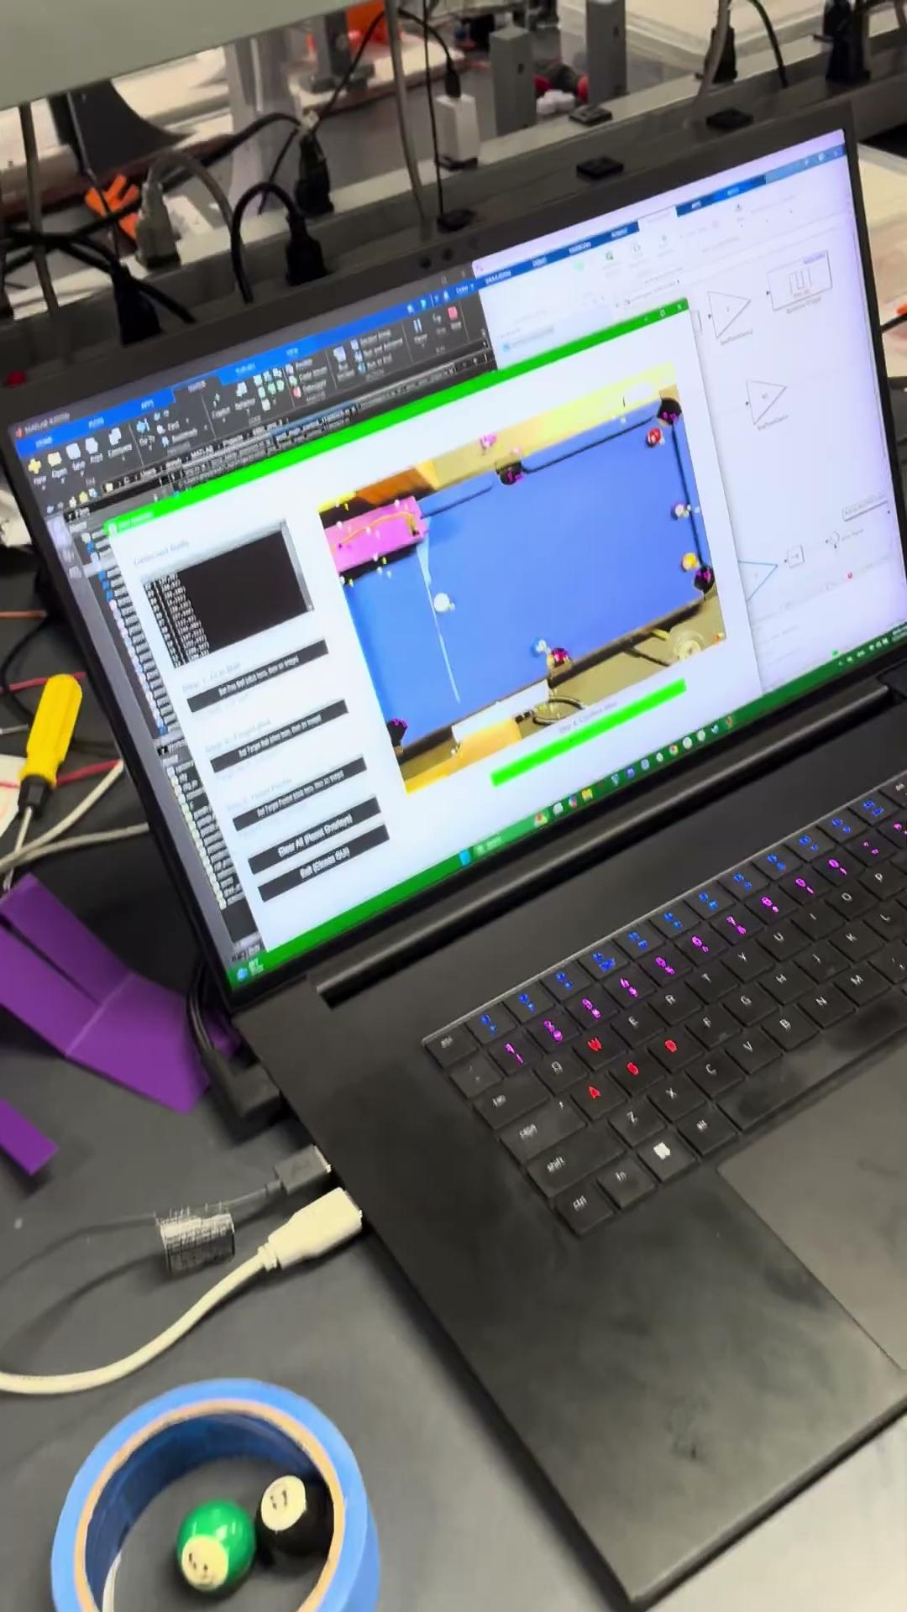

Demo
Clemson University | Electrical & Computer Engineering

Slide 4
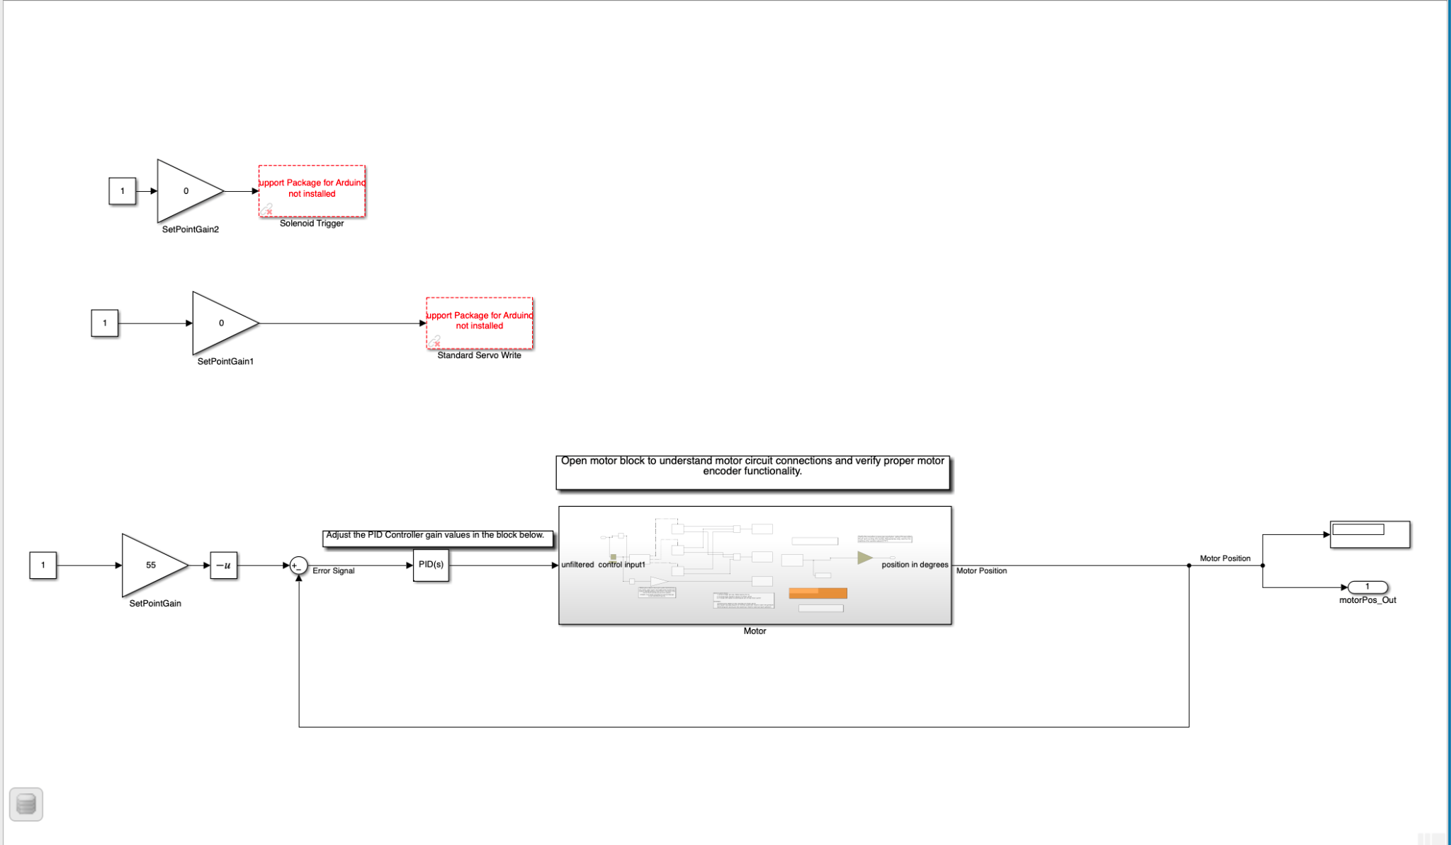
Simulink
Clemson University | Electrical & Computer Engineering

Slide 5
Performance Analysis
Strengths
Accurate potting on short/medium shots
Smooth closed‑loop motion control with minimal vibration
Fast GUI input → shot execution cycle
Quiet and safe operation during repeated trials
Challenges
Long shots struggled due to angular tolerance limits
  Small degree errors compounded over distance
  Reduced accuracy on long‑range cue ball alignment
3D‑printed components introduced mechanical play
  Extra flex and looseness in mounts caused solenoid, servo, and DC motor to move more than intended
  Reduced precision and repeatability of cue strike
Improvement Opportunities
Refine angular calibration to reduce tolerance error
Use higher‑resolution sensors for better shot alignment
Replace critical 3D‑printed parts with machined or reinforced components to reduce play
Improve cue mount rigidity for consistent striking
Enhance control algorithms for long‑distance precision
Clemson University | Electrical & Computer Engineering

